Slide 1
Globalisation 2

Slide 2
Recap from last week
Globalisation and the modernist paradigm
Sceptics/transformationalist/hyperglobalist
Autonomy of the nation state
‘cultural homogenisation’ and ‘cultural heterogenisation’
Globalisation and localisation :
‘multi-nationals such as Nike, Micro-soft and Starbucks have sought to become the chief communicators of all that is good and cherished in our culture: art, sport, community, connection, equality……all of the collective longings of our culture have been projected onto lattes and trainers (Klein).
Modernity (imperialism/colonialism) versus postmodernity (globalisation/postcolonialism).

Slide 3
Post-Colonialism and Globalisation
Appadurai - ‘scapes’
‘...both persons and images often meet unpredictably, outside the certainties of home and the cordon sanitaire of local and national media effects. This mobile and unforseeable relationship between mass- mediated events and migratory audiences defines the core of the link between globalization and the modern’ (4).

Slide 4
Scapes
Five dimensions of global cultural flows :
ethnoscapes
mediascapes
technoscapes
financescapes
ideoscapes

Slide 5
"although in the process the separation between Europeans and natives was an
insidious and fundamentally unjust one, most of us should now regard the historical experience of empire as a common one" (Edward Said 1993:xxiv)

Slide 6
"cultural action, the making and remaking of identities, takes place in the contact zones, along the policed and transgressive intercultural frontiers of nations, peoples and locales" (Clifford 1997: 7).

Slide 7
Transculturation
How do groups select and invent from materials transmitted to them from a dominant or metropolitan culture ?
Fernando Ortiz
Mary Louise Pratt - Imperial eyes : Travel writing and Transculturation
Transculturation from periphery to core

Slide 8
Globalisation and inflections
Page 124
Man with a bicycle
Yoruba, Nigeria 20th century
Wood and paint H. 35 3 4 in.
The Newark Museum
Caption :
‘The influence of the Western world is revealed in the clothes and
bicycles of this neo-traditional Yoruba sculpture which probably
represents a merchant en route to market’ (423).

Slide 9
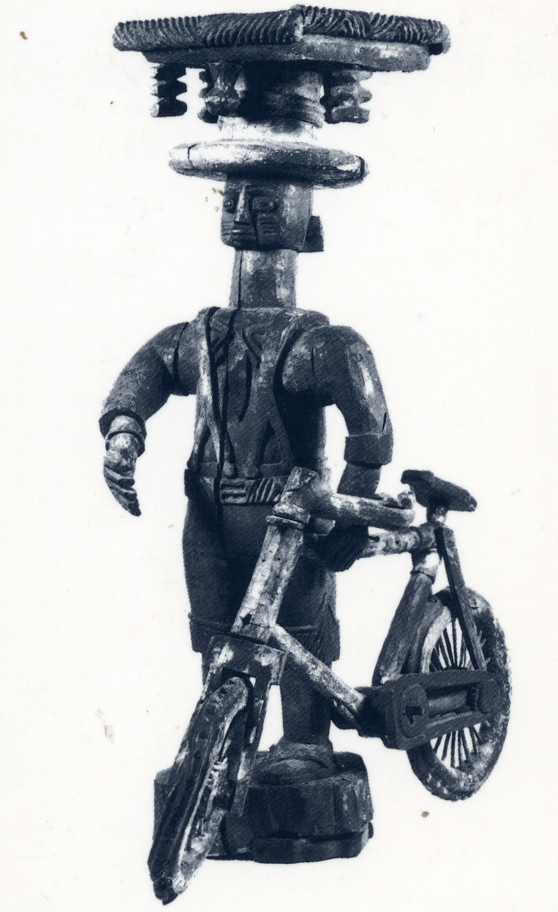

Slide 10
Kwame Anthony Appiah
‘Yoruba Man with a Bicycle was produced by someone who did not
care that the bicycle is the white man's invention - it is not there to
be the other to the Yoruba self; it is there because someone cared
for its solidity; it is there because it will take us farther than our feet
will take us; it is there because machines are now as African as
novelists... and as fabricated as the kingdom of Nakem’ (441).
"If there is a lesson in the broad shape of this circulation of cultures, it is
surely that we are all already contaminated by one another, that there is
no longer a fully autochthonous, pure-African culture... (just as there is...no
American culture without African roots) (439)

Slide 11
Manthia Diawara
"sufficiently wired Africa to the West, from the public sphere to the bedrooms, to the extent that Africans are isolated from nation to nation but united in looking toward Europe and America for the latest news, politics and culture" (Diawara 1998: 103)

Slide 12
Hybridity
“Hybridisation is an antidote to the cultural differentialism of racial and nationalist doctrines because it takes as its point of departure precisely those experiences that have been banished, marginalised, tabooed in cultural imperialism’ (Pieterse, 2004 : 53)
"this interstitial passage between fixed identifications opens up the possibility of a cultural hybridity that entertains difference without an assumed or imposed hierarchy" (Homi Bhaba, 1994: 4).

Slide 13
AbdouMaliq Simone (1998)
"many Africans still see the city as an 'invasion', as an unwelcome and unexpected intrusion on their preferred life rhythms and sensibilities; it is something that must be accommodated, or at least tolerated, occasioning an entire vocabulary of microresistance expressed in how people maintain both its physical and cultural spaces" (1998: 71).

Slide 14
Bill Ashcroft
"possibly one item of clothing which asserts, more strongly than any other the dominance of sign value over use value. Its utility as clothing is well attested globally, but its reason for existence almost seems to lie entirely in its value as a sign" (1998: 17).
Jonathan Friedman
‘ethnic and cultural fragmentation and modernist homogenization are not two arguments, two opposing views of what is happening in the world today, but two constitutive trends of global reality……………..an aspect of a more general strategy or set of strategies for the establishment and/or maintenance of selfhood and a negotiation between self- definition and the array of possibilities offered by the capitalist market (Friedman, 1990: 311).

Slide 15
Amitav Ghosh
'And none of this was new: their grandparents and ancestors and
relatives had travelled and migrated too, in much the same way as
mine had, in the Indian subcontinent - because of wars, or for money and jobs, or
perhaps simply because they got tired of living always in one place. You could
read the history of this restlessness in the villager's surnames: they had names
which derived from the cities in the Levant, from Turkey, from faraway towns in
Nubia; it was as though people had drifted here from every comer of the Middle
East. The wanderlust of its founders had been ploughed into the soil of the village:
it seemed to me sometimes that every man in it was a traveller' (Ghosh in Clifford
1997: 2).

Slide 16
Maryse Conde
"reaching out beyond national and linguistic borders both in actual exchanges and transatlantic influences and in the expressive imagination of diasporic black communities" (1).
"what was negritude, what was Pan-Africanism if not forms of globalization, the implied project of complete identity and an active solidarity among the black peoples?" (2).

